Slide 1
Building a Business Letter

Slide 4
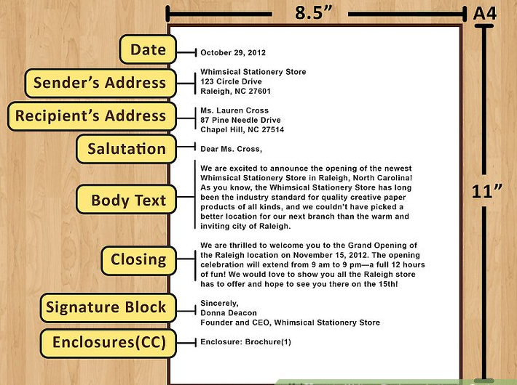

Slide 5
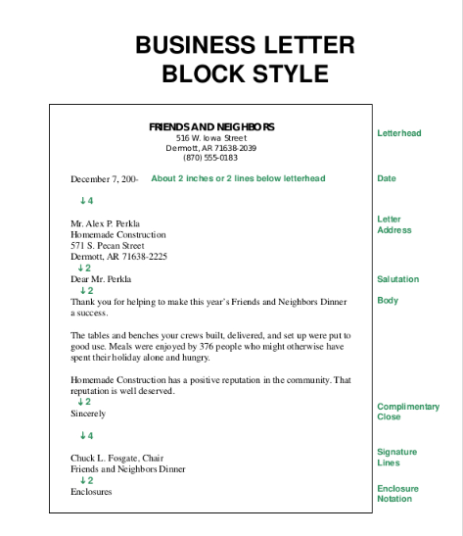
Block Style

Slide 6
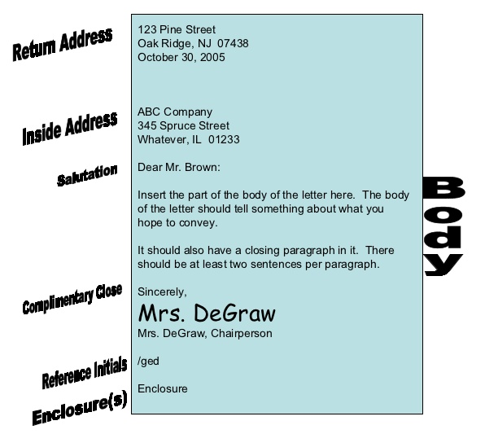
Block Style

Slide 7
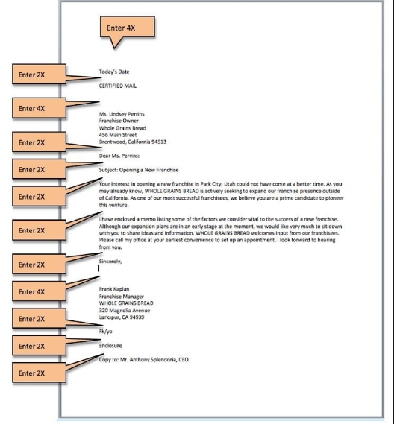
Line Spacing Between Parts

Slide 8
INSIDE ADDRESS

Slide 9
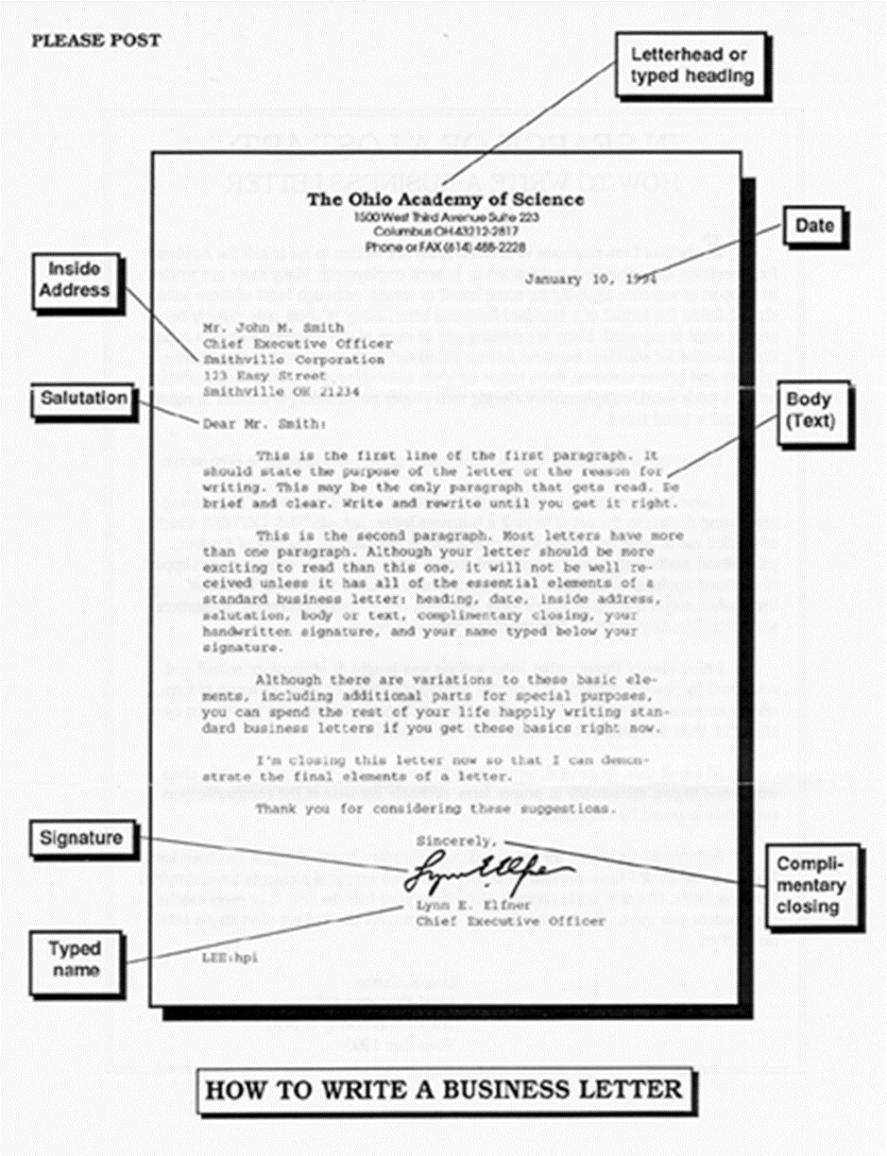
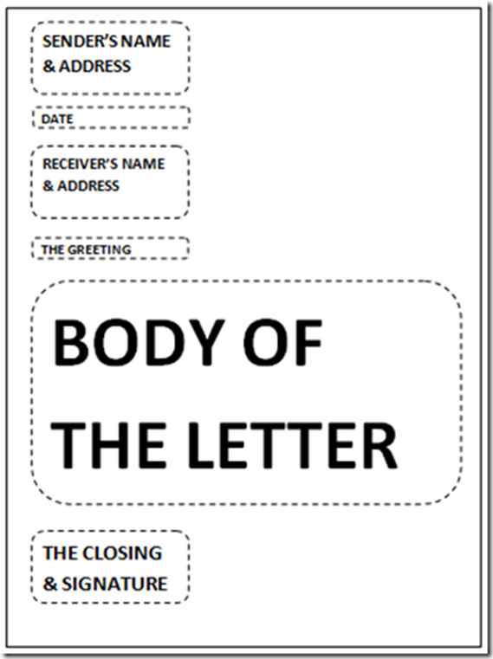
Business Letter Formats
Business Letter with Letterhead
Business Letter without Letterhead

Slide 11
Remember to use this PowerPoint as your
Study Guide

